Slide 1
Robust Fraud Detection
via Supervised Contrastive Learning
Authored by: Vinay M.S, Shuhan Yuan, Xintao Wu
Presentation by: Kevin Richard

Slide 2
Motivation : Fraud Detection
Most online platforms like social networking sites and Cloud systems handle huge volumes of user connections and activity.
Due to the anonymity and openness of the internet, huge amounts of fraudulent and malicious activities also take place among regular user activities.
Why is it difficult?
Most available labeled datasets have much more normal session than malicious session data.
This can cause issues like over-fitting and diversity issues when training and testing with these data.
Augmented data samples also do not have diversity as they will be closer to the original data and not similar to the probable unseen malicious data.

Slide 3
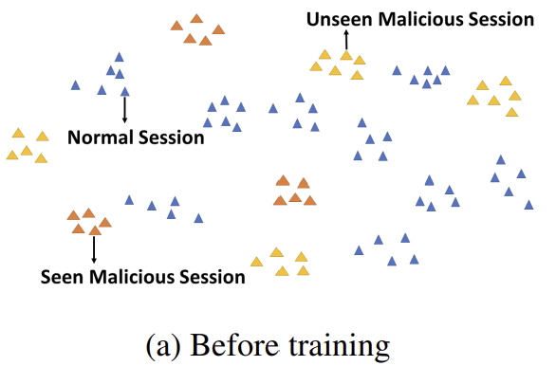
Related Work
Anomaly Detection:
It assumes the availability of normal samples and aims to learn a decision boundary based on the normal data distribution.
These approaches only address the closed-set fraud detection task.
Insider Threat Detection:
The do not specifically address the dataset imbalance challenges in detecting insider threats.
These approaches only address the closed-set fraud detection task.
Open-Set Recognition:
The paper takes a bunch of papers as example and also as baseline.
But seems, theirs performs much better than others.
They did not disclose results of a semi-supervised related paper.

Slide 4
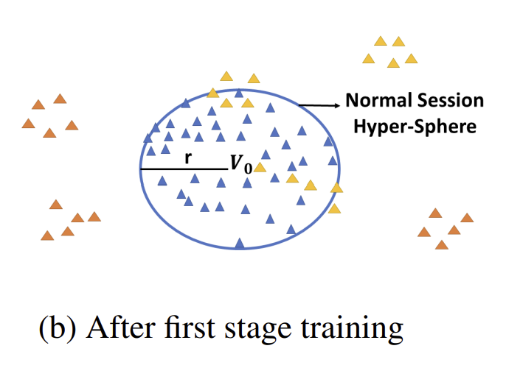
Proposal : ConRo - Two stage training framework
The main goal is to generate augmented session data which are similar to seen and also to unseen malicious session data.
First Stage :
Supervised contrastive learning:
It learns features of normal sessions and learns to differentiate normal and seen malicious sessions.
DeepSVDD :
It compresses normal session representations inside a minimum volume hyper-sphere.

Slide 5
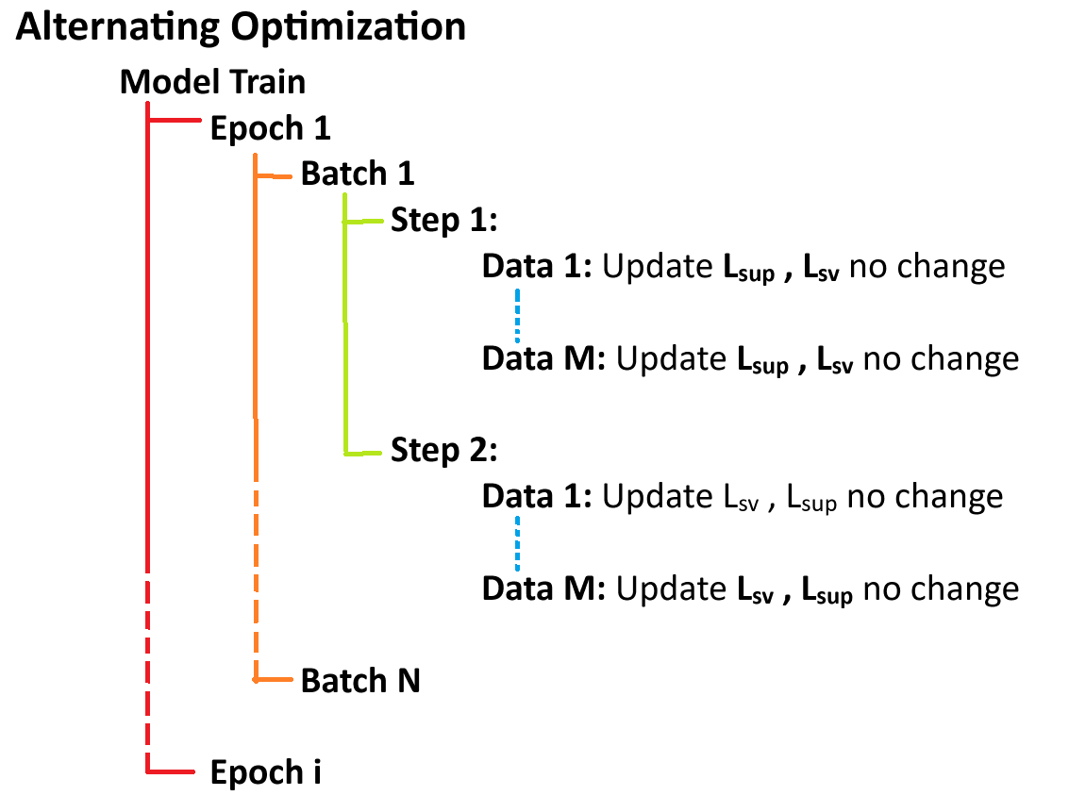
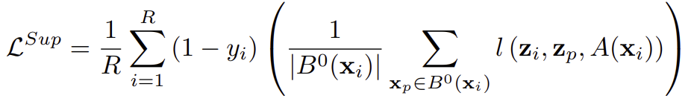
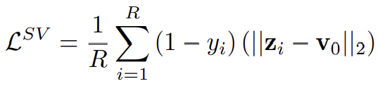

First Stage
Joint Optimization:
Both loss functions are updated simultaneously.
From ablation analysis, not recommended.
Alternating Optimization approach ( Used here ):
Loss function of supervised learning and DeepSSVD are taken in an alternating way.
See diagram, it definitely increases latency and resource consumption.
Stage 1 Loss function:

Slide 6
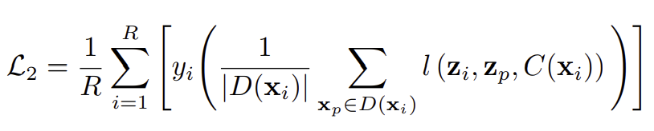
Proposal: ConRo - Two stage training framework
Second Stage :
Generate augmented potential malicious session data:
Similar to seen-malicious session data.
Which diverges significantly from seen-malicious session data.
Supervised contrastive learning:
We again use supervised contrastive to round up final predictions, with below loss function:

Slide 7
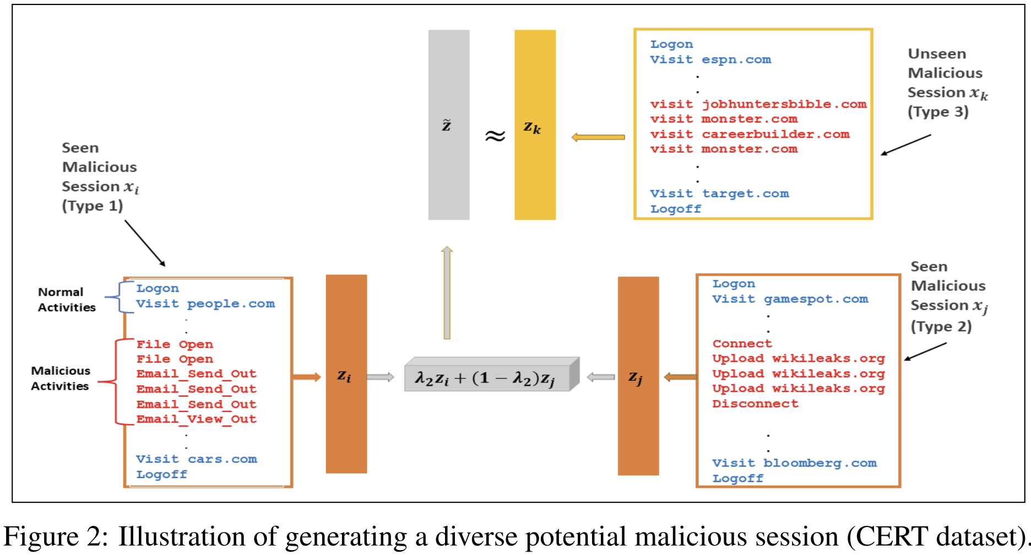





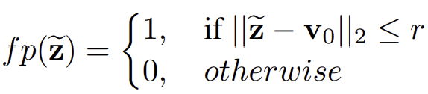
Augmented Malicious Session Data
Close:
Divergent:
Treat False positives:

Slide 8
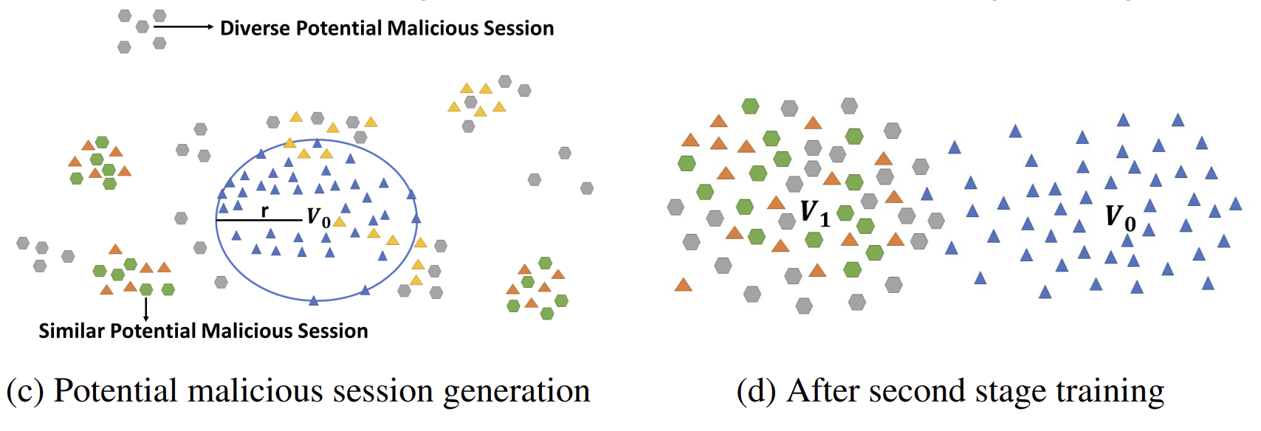
Finally: Supervised contrastive learning

Slide 9
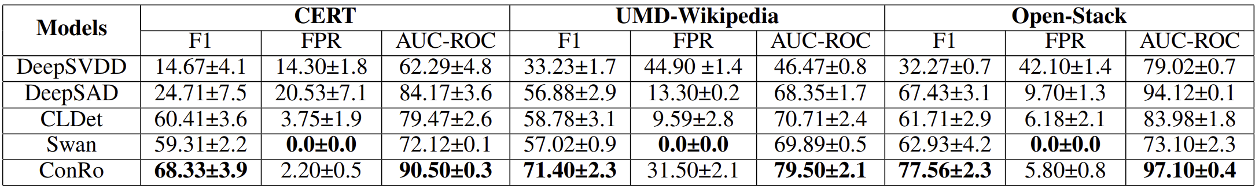

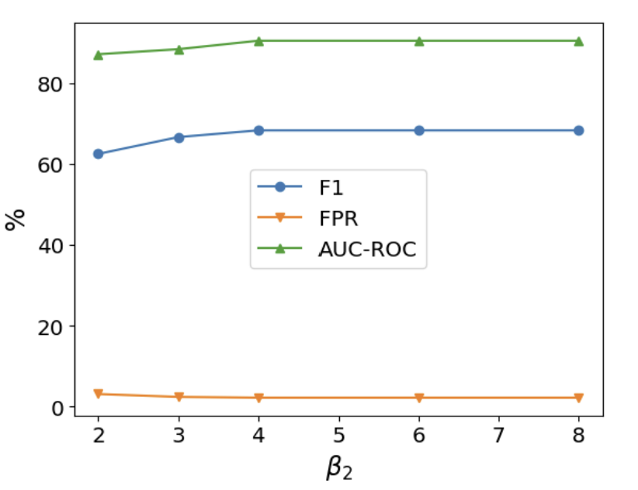
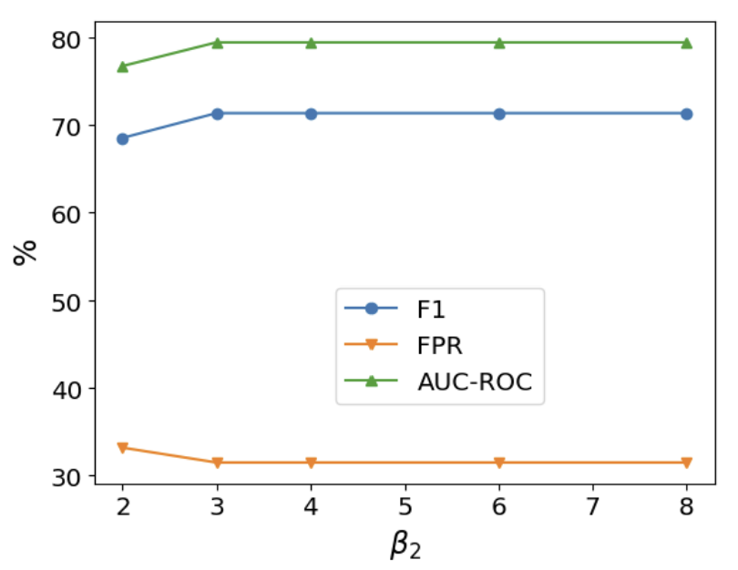


Experimental Results & Sensitivity Analysis:
F1 Score & FPR : Best if higher
AUC-ROC : Best if lesser.

Slide 10


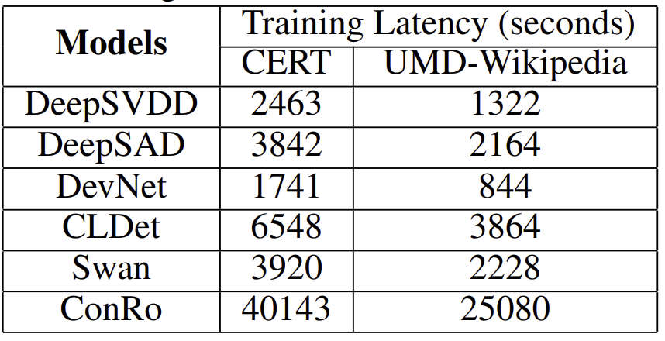


Performance Metrics:
F1 Score:
FPR (False positive Rate) :
AUC-ROC (Area Under ROC curve):
Trade off between True Positive rate and False Positive rate.

Slide 11
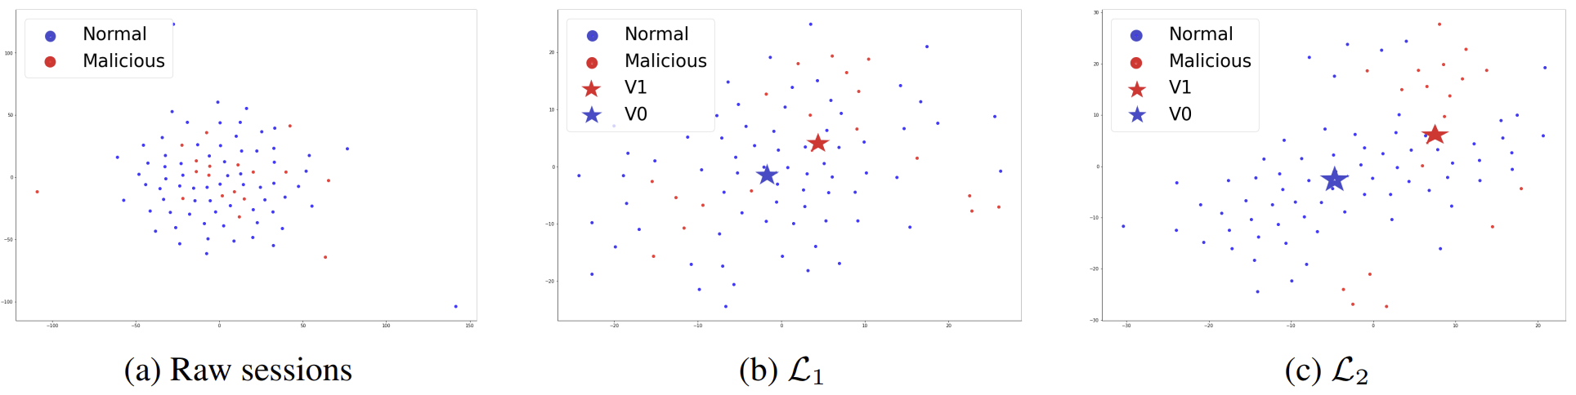
Output : CERT Dataset

Slide 12
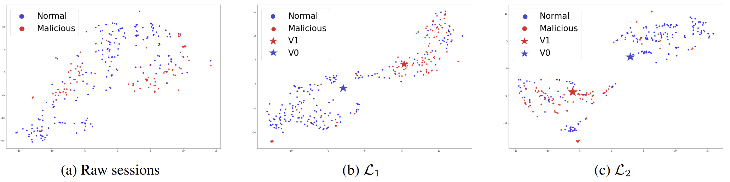
Output : UMD-Wikipedia Dataset

Slide 13
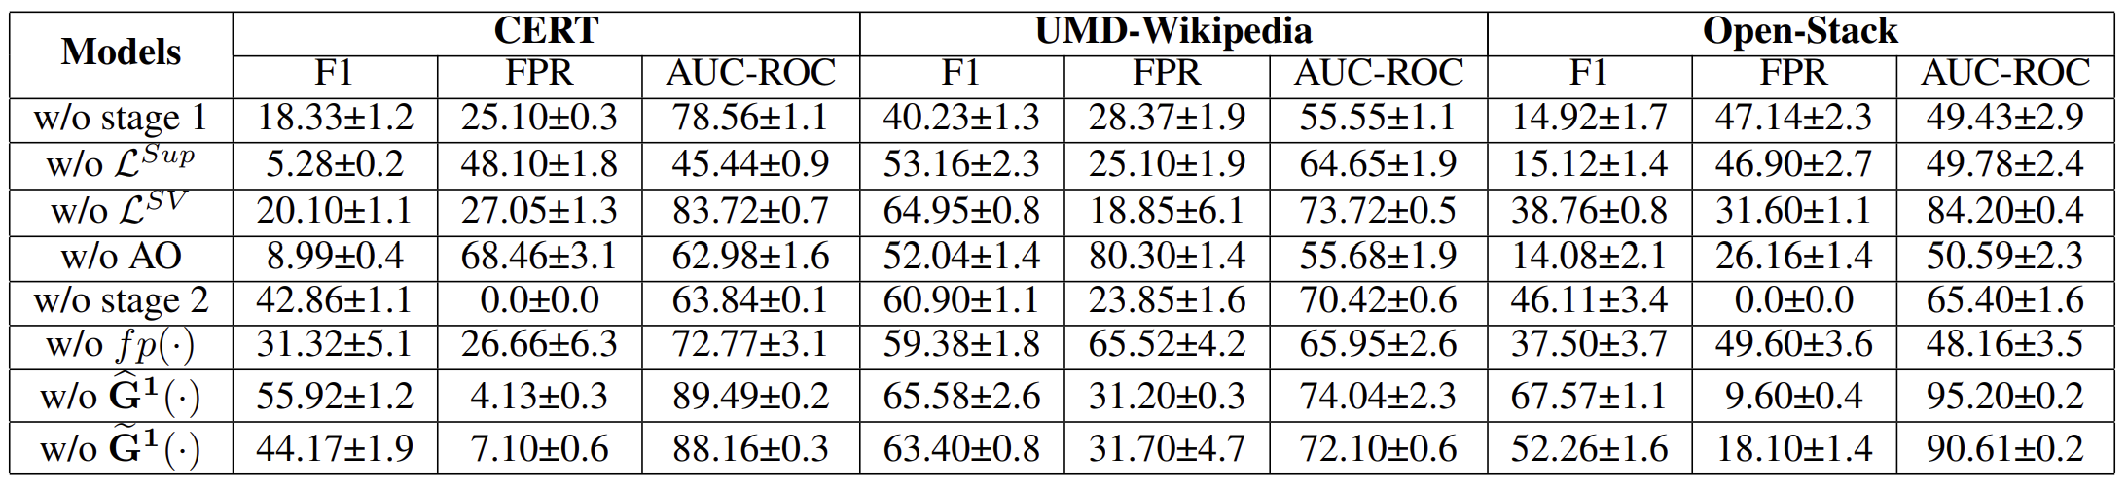
Ablation Analysis

Slide 14
Conclusion:
ConRo is a robust and fraud detection framework, which performs specifically well in a scenario where only few malicious sessions with limited diversity are available for training.
The Data augmentation techniques and combination of Supervised Contrastive & DeepSVDD losses are effective for this requirement.
Theoretical analysis was performed to understand the reason between its effectiveness which are not covered in this presentation.

